Slide 1
WELCOME TO THE MARCH 30TH TREASURERS MEETING

Slide 2
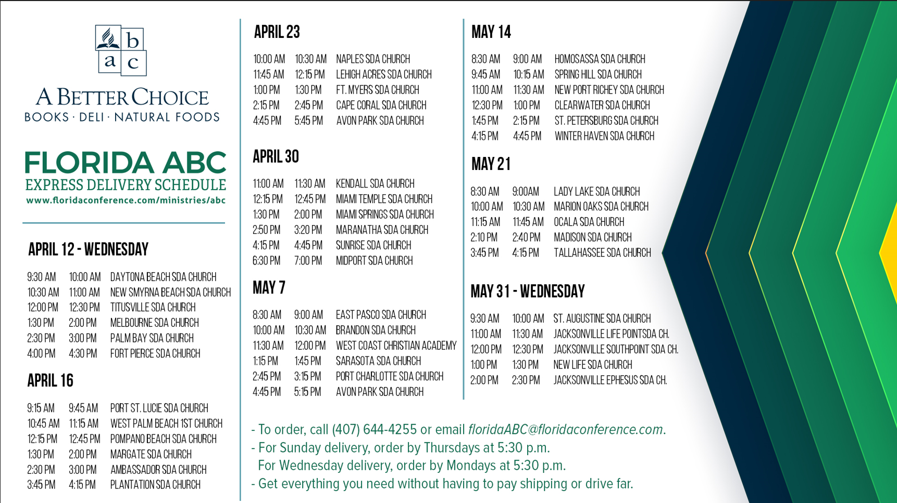

Slide 3


Slide 4
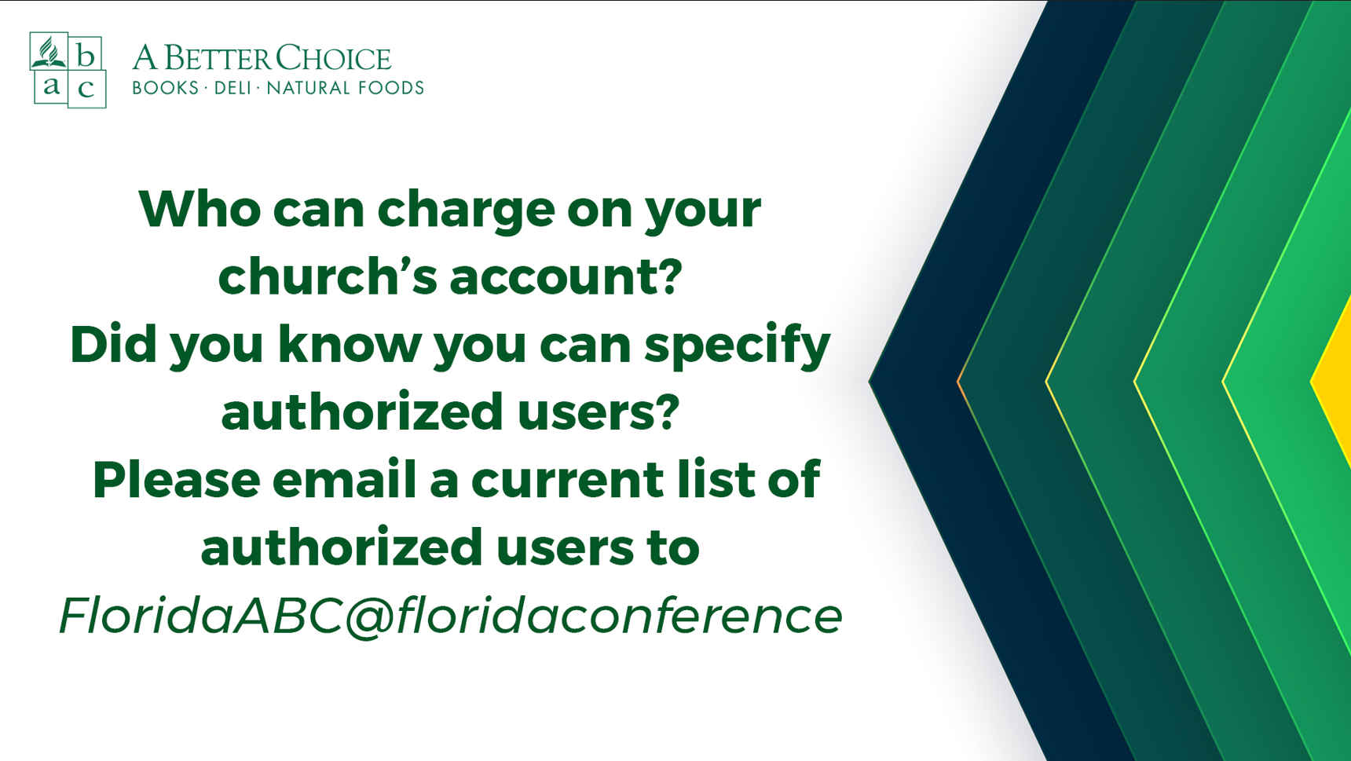

Slide 5


Slide 6


Slide 7
Are there topics you would like for us to cover at our future meetings?
Please email karen.hanke@floridaconference.com

